Slide 1
Face Recognition System
Team : Matta Sree Keerthi
N.Anirudh
Manohar. I
R.B.Srinivas
Shanmukh Srinivas

Slide 2
Brief Overview
Abstract
Software and toolboxes used
Data and System Requirements
Model Description
Main Algorithms
UML Diagrams

Slide 3
Abstract
Face recognition belongs to a class of pattern recognition.
Nowadays the main problem faced by the entire world is “lack of security”.
The security is provided by “Biometrics” in order to safeguard the confidential data of various organizations.
Here we use a face recognition setup in order to provide security.
The main idea of this system is that it contains a pre loaded dataset and when a person wants an authentication to the secret data ,he has to use his face as a key or password to get access to the data.
Hence this face recognition system provides utmost security in order to safeguard our secret data.

Slide 4
Software to be used
IDE - MATLAB
Toolboxes- image processing toolbox
database- ORL database

Slide 5
Data and System Requirements
Input - Image or a screenshot of a video
Output – Set of recognized images
Database – Collection of various images of people along with various details relevant to them.
----------------*---*---*---*---*-----------------
Operating System – windows 7,windows 8,windows 8.1 or Linux

Slide 6
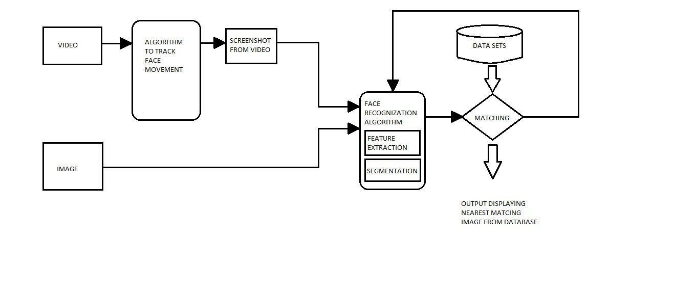
Model Description

Slide 7
Main Algorithms
Here ,PCA(Principal Component Analysis) and DCT(Direct Cosine Transforms) are used for feature extraction.
The classifier used is Euclidian distance.
The algorithms works well in various conditions such as image size variations ,pose and illumination variations and various sizes of datasets.

Slide 8
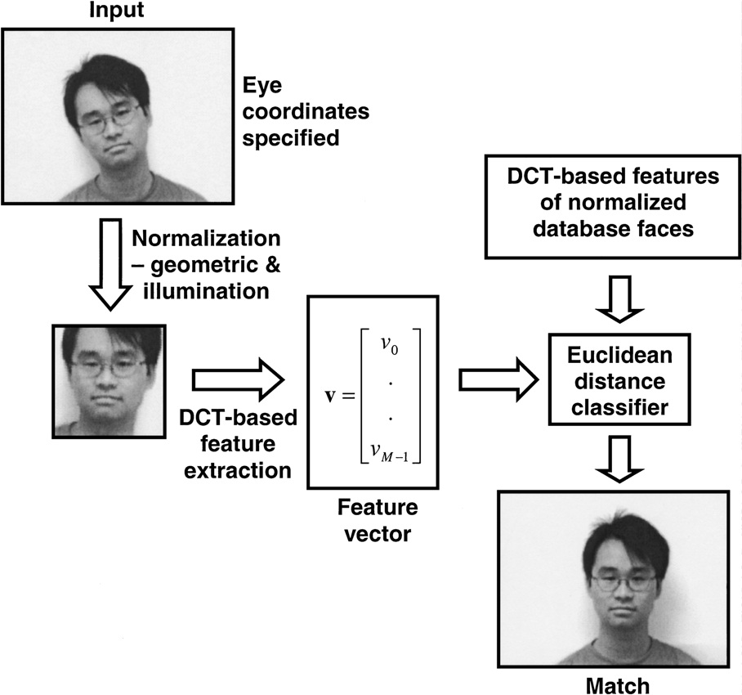
DCT Based Face Recognition System

Slide 9
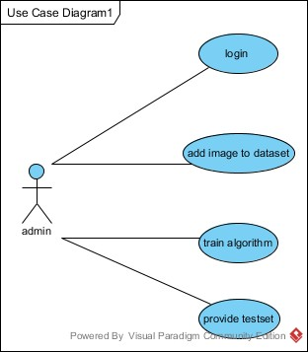
USE CASE DIAGRAM
USE CASE NAME | Admin
Participating actor instances | admin
Entry conditions | Admin must have username and password in order to enter into the system
Flow of events | Admin should login first. He/she trains the system. He /she feds the test set.

Slide 10
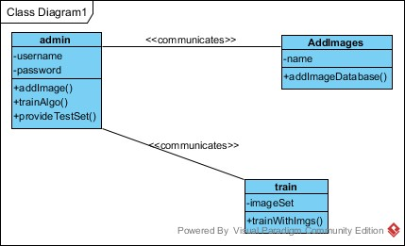
CLASS DIAGRAM

Slide 11
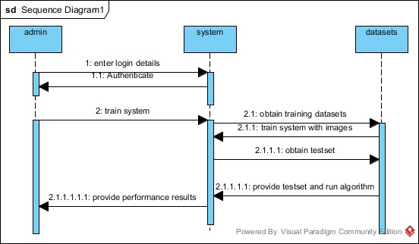
Sequence Diagram

Slide 12
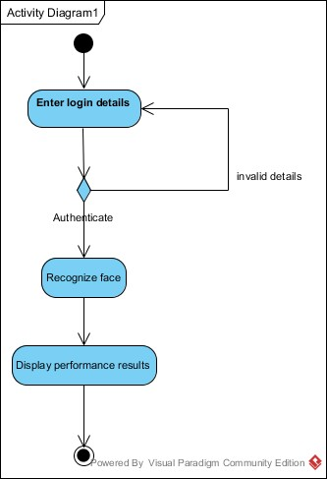
Activity Diagram

Slide 13
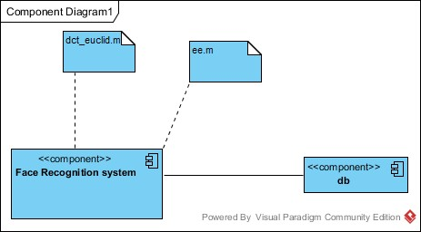
Component Diagram

Slide 14
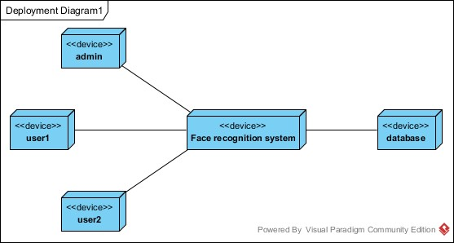
Deployment Diagram

Slide 15
Thank You

